Slide 1
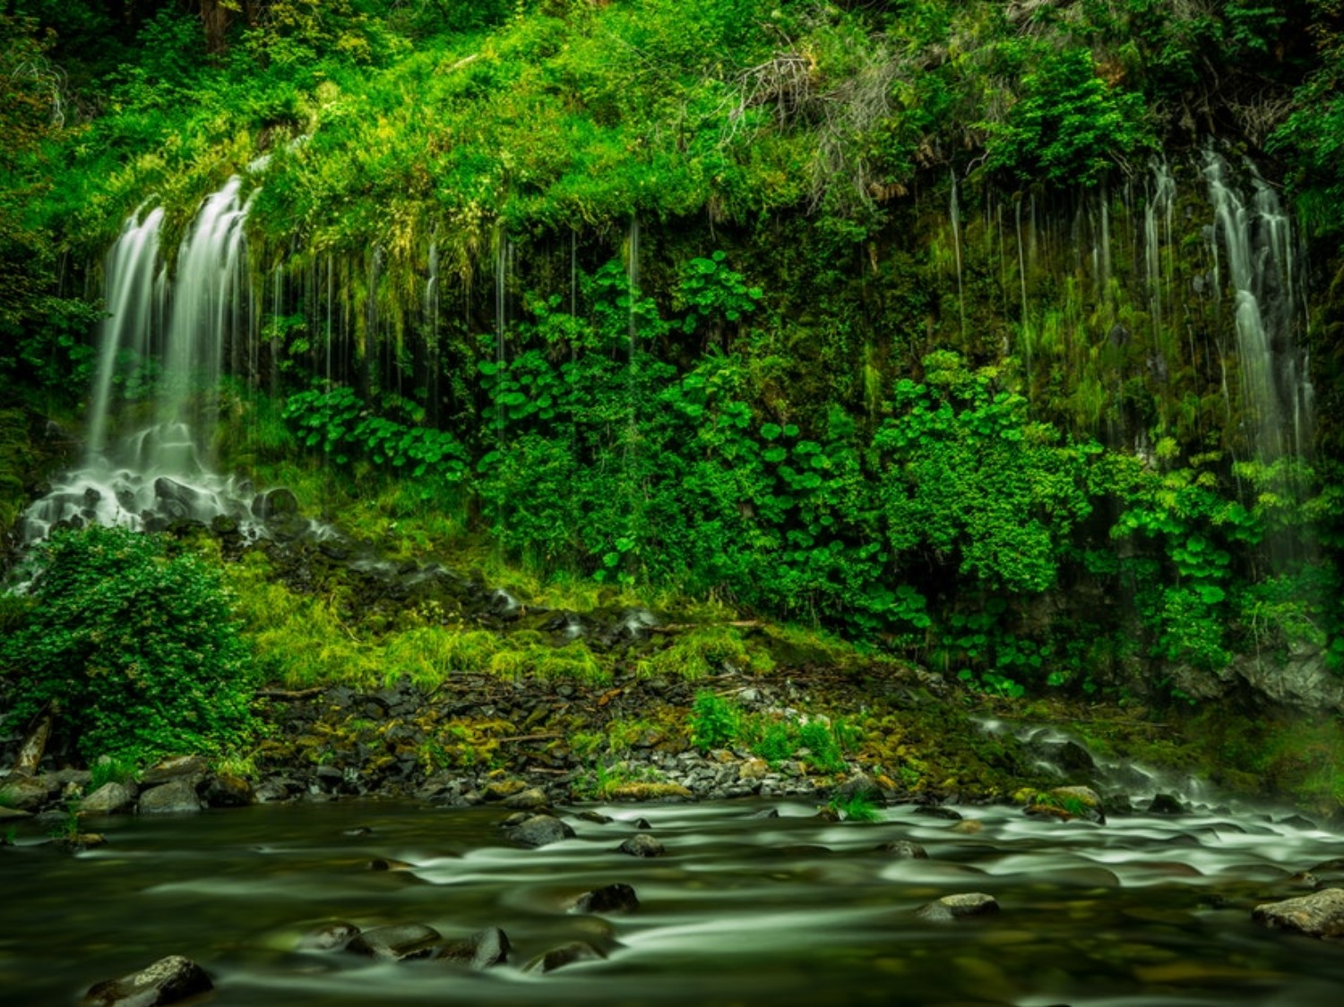
WATER RESOURCE

Slide 2
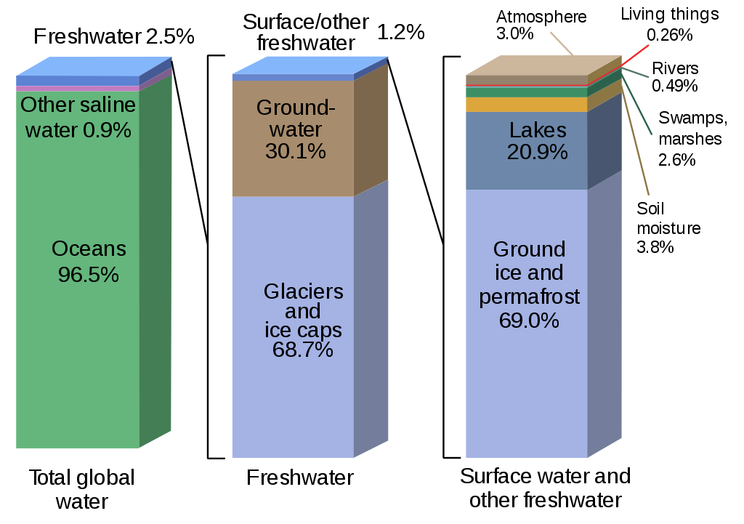
Water Resources
Water availability

Slide 3
Properties of water and its effects
It has the highest specific heat, due to which it warms up and cools down very slowly without causing shocks of temperature jerks to the aquatic life.
It has a high latent heat of vaporization Hence, it takes a huge amount of energy for getting vaporized. That’s why it produces a cooling effect as it evaporates.
It is an excellent solvent for several nutrients. Thus, it can serve as a very good carrier of nutrients, including oxygen, which are essential for life. But, it can also easily dissolve various pollutants and become a carrier of pathogenic microorganisms.
Due to high surface tension and cohesion it can easily rise through great heights through the trunk.
It has an anamolous expansion behaviour. It is because of this property that even in extreme cold, the lakes freeze only on the surface. Being lighter the ice keeps floating, whereas the bottom waters remain at a higher temperature and therefore, can sustain aquatic organisms even in extreme cold.

Slide 4
Importance of water
Water is the basic component of every living cell.
Water is one of the input required for agriculture.
Industries consume water for cooling, heating and other processes.
Electricity generation
Waterways are used for inland transport.
Water may be used for obtaining common salt.
Water provides habitat to aquatic flora and fauna.

Slide 5
Water usage
Agriculture – 70%, Municipal – 11%, Industrial – 19%
Average requirement is 20 – 40 liter per head per day (Twice of the usage 50 years ago)
About 30% of fresh water is used by US (4% of world population) where, middle east (5% of world population use 1% of fresh water).
More than 1 billion people don’t have fresh water supply.
Presently 31 countries facing water scarcity.
By 2025, 48 countries will face water shortage (including India).
By 2050, 4 billion people will suffer water shortage.

Slide 6
Conflict over water
Tigris and Euphrates conflict (Turkey – Syria – Iraq)
Nile conflict (Egypt – Ethiopia – Sudan)
Jordon river conflict (Israel - Lebanon – Jordon – Palestine)
Aral sea conflict (Kazakhstan – Uzbekistan – Tajikistan – Turkmenistan)
Indus water treaty (Jhelum - Chenab: Pakistan, Satluj, Ravi, Beas: India)
Kaveri dispute
  Origins in brahmagiri hill (Karnataka)
  Then enters Tamil Nadu
  First agreement in 1892
  Mettur dam was built in 1970 – Tamil Nadu raised objection
  1991 a tribunal is formed – Karnatake opposed
Satluj-Yamuna Link (SYL) canal dispute (Punjab – Haryana)

Slide 7
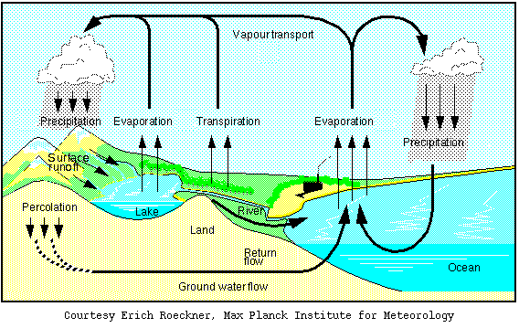
Water cycle

Slide 8
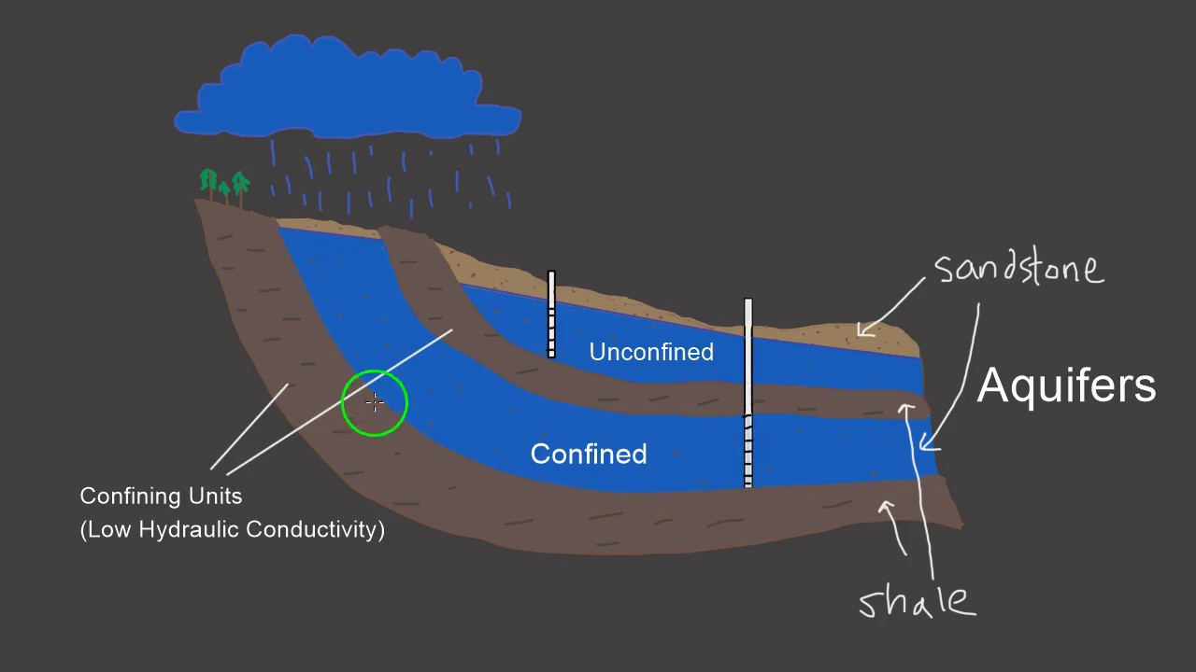
Source of water
Surface water
  Rainfall, snow
Ground water
  Confined aquifer
  Unconfined aquifer
Aquifer
  An aquifer is a body of porous rock or sediment saturated with groundwater. Groundwater enters an aquifer as precipitation seeps through the soil. It can move through the aquifer and resurface through springs and wells.

Slide 9
Unconfined aquifer
These are overlaid by permeable earth materials and they are recharged by water seeping down from above in the form of rainfall and snow melt.
Confined aquifer
These are sandwiched between two impermeable layers of rock or sediments and are recharged only in those areas where the aquifer intersects the land surface.
Sometimes the recharged area is hundreds of kilometers away from the location of the well.
Groundwater is not static, it moves, though at a very slow rate of about a meter or so in a year.

Slide 10
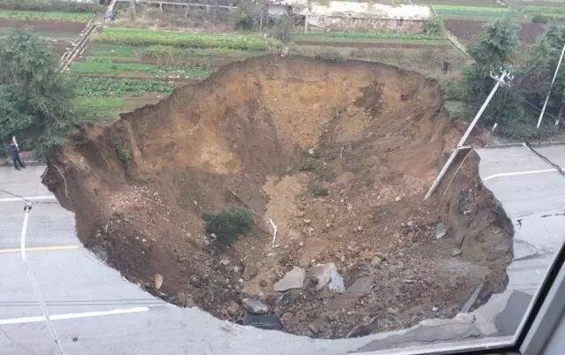
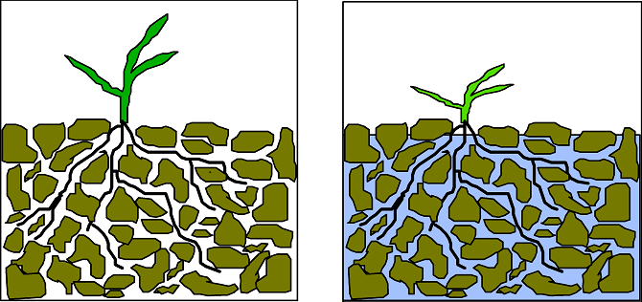
Over exploitation of ground water
Ground subsidence
Lowering water table
Reduced surface water flow
Increased power consumption
Water logging
Ground water pollution

Slide 11
Ground subsidence
When groundwater withdrawal is more than its recharge rate, the sediments in the aquifer get compacted, a phenomenon known as ground subsidence.
Huge economic losses may occur due to this phenomenon because it results in
the sinking of overlying land surface.
The common problems associated with it include structural damage in buildings, fracture in pipes, reversing the flow of sewers and canals and tidal flooding.

Slide 12
Lowering water table
Mining of groundwater is done extensively in arid and semi-arid regions for irrigating crop fields.
However, it is not advisable to do excessive mining as it would cause a sharp decline in future agricultural production, due to lowering of water table.
water Logging
When excessive irrigation is done with brackish water it raises the water table gradually leading to water-logging and salinity problems.

Slide 13
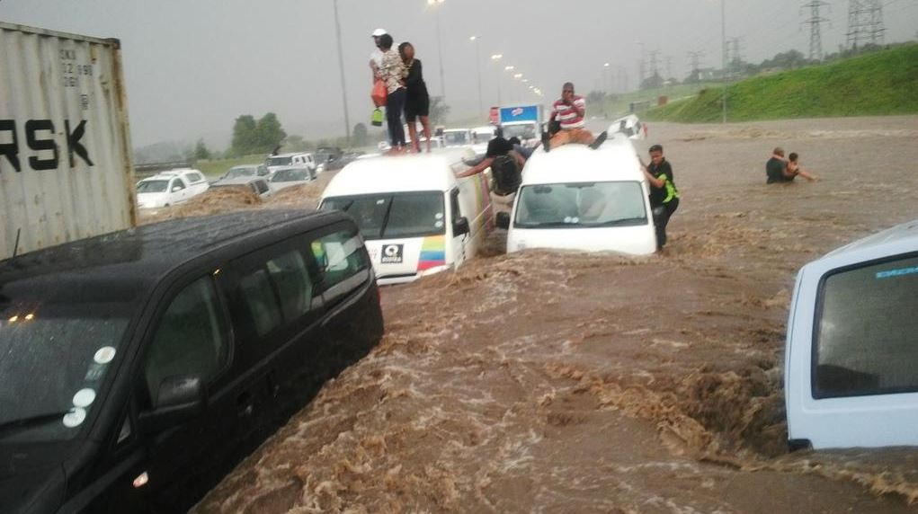
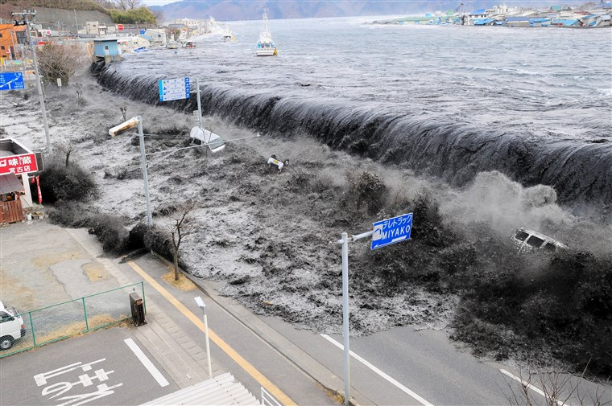
Water calamities (Flood)
Types
  Flash flood: Heavy rainfall, dam failure, river obstruction
  River flood: Precipitation over large catchment area, melting of snow
  Coastal flood: Hurricanes, tropical cyclone, tsunami
Causes
  Upslope factors
    Melting of snow
    Intense rainfall
    Time of concentration
  Downslope factors
    Dams and reservoirs
    Tides
    Natural events: Tsunami, Storm

Slide 14
Water calamities (Flood)
Effects
  Negative effects: Loss of life and property, damage to crops, damage to power transmission, water-borne diseases, difficulty in health facilities, decline in tourism
  Positive effects: Distribution of nutrients, relocation of fishes

Slide 15
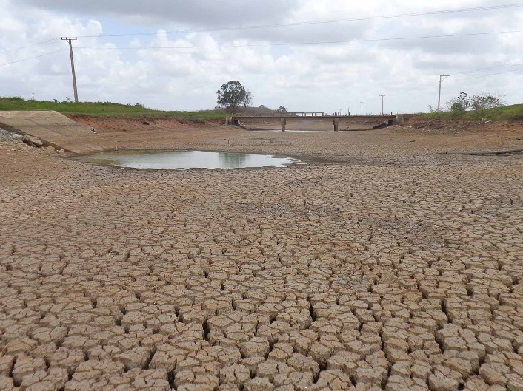
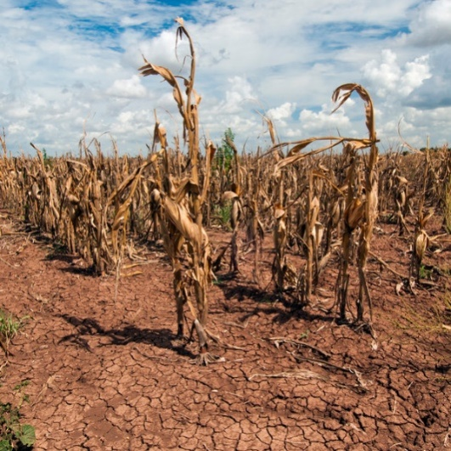
Water calamities (Drought)
Types
  Meteorological drought: Less rainfall
  Hydrological drought: Low stream flow
  Agricultural drought: Low soil moisture
Causes
  Dry season
  Climate change
  Erosion and human activity

Slide 16
Water calamities (Drought)
Effects
  Decrease in crop growth
  Dust storm
  Famine and mal nutrition
  Habitat change
  Mass migration
  Reduced electricity
  Wild fire

Slide 17
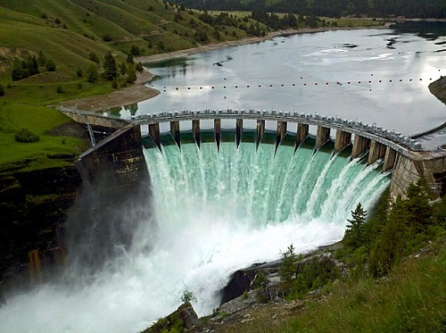
Dams
Benefits
  Electricity generation
  Employment
  Irrigation water supply
  Drinking water supply
  Reduction in famine
  Flood control

Slide 18
Dams
Problems
  Displacement of tribal people
  Loss of forest
  Changes in aquatic environment
  Waterlogging near reservoir
  Breeding of vectors
  Microclimatic changes
  Reduced water flow
  Flash flood
  Salt water intrusion
  Sediment carrying nutrients get deposited in reservoir.
  Outbreak of vector-borne diseases like malaria.

Slide 19
Thank You

